Slide 1
Xlta
Sep 2025
Pitch Deck

Slide 2
Feasibility Study Requirements
Business analysis:
  The general Ecosystem of investment
    KSA vison ….
  The sector I am targeting
    At the end of these pages they are looking to
      Go or no go
  The problem
  What I solve
Operational strategy
Financial Study
  Profit/loss
  Operational needs
Monshaat doensn’t help with feasibility study
To go to the Saudi Center for Business
Check for the business
Look at the
Talk to Waleed Bahkali (bakri)
Tech
Talk to Hassan Al Zahrani
For the Financial Manager
Talk to Hazim Al Qahtani
For
Talk to Nader Al Otaibi
Strategy

Slide 3
We have deeply studied investor journey to understand the problems investors face and where our value is most maximized
Business Case
Investor Journey As They Are Making A New Position (Illustrative)
Starting Point
End
Comment
Decision
Action
Investor
Investor Make a request for a new position on their corresponding Broker
Broker
Does Investor have enough funds for the request in investment account?
Execute request depending on buy request (market price, limit, trace, etc.)
Settlement of cash for stock bought²
Deposit stock in investor investment account
Yes
End
No
End
Exchange
Matched buy order with sell order
Confirm execution
Xlta will give investors the option of getting funds to continue the process
Notes: 1) we haven’t shows pre-trade steps for the sake of simplifying the graph, 2. Investors might not need to have cash at the time of making the order but they must have it at the point of settlement
Source: Xlta analysis

Slide 4




We will provide investors with the option to get instant funds to ensure seizing the opportunity and simplifying the process of acquiring funds
Business Case
The Options Investors Have When They Lack Funds
Wait to have funds available
Get a personal loan from bank
Get a loan through Xlta
Investors have the option to wait for funds to be available depending on how they usually make recurrent income.
Investors could contact their bank of choice to get personal loan to fund their investment
Investor could leverage Xlta service to receive an instant and discounted loan
At a average weekly volatility of 12+%, investors are bound to lose great opportunities in the market
To get a personal loan, investors need 24 hours to couple of days for the paperwork
Interest rate on personal loans varies from 3.5-6.7 depending on duration
Investor could leverage Xlta service to receive an instant (3 sec) and at competitive interest rate
Notes: 1. All Xlta loans must be paid over 4 installments within a year
Source: Xlta analysis, NYU V-Lab
Out Value Proposition

Slide 5
Maturity Premium
Maturity Premium
Maturity Premium
Liquidity Premium
Liquidity Premium
Inflation Rate
Inflation Rate
Risk Free Rate
Risk Free Rate
Personal Loan
Xlta`` Loan

Slide 6


We will bring our Invest Now Pay Later solution to provide instant loans at competitive interest that can be paid over 4 payments
Business Case
Xlta Value Proposition
Payment 1
Payment 2
Payment 3
Payment 4
Investor buys a position within the market at 0 cash upfront
Investor makes payment 1
Investor makes payment 2
Investor makes payment 3
Investor makes payment 4
Xlta funds purchase request with competitive interest on investor
Source: Xlta analysis

Slide 7
In the first year from our launch, we will be able to generate SAR 16 Million in revenue through provision of instant loans for investors
Business Case
Assumptions
Market Size
Total Addressable Market (TAM)
Tadawul total traded value ≈ SAR 5.3 trillion
Retail investors account for roughly 30 of turnover ≈ SAR ~1.6–1.8 trillion annually
SAR 1.7 Trillion
SAR 83 Billion
Serviceable Addressable Market (SAM)
We assume that 15% of the retail investors would be interested in receiving Xlta service
SAR 838 Million
Serviceable Obtainable Market (SOM)
We assume we will be able to take 1% of the the SAM for the first year
If we charge 2% on the Riyal, we will be able to make SAR 16 Million in revenue in the first year
Source: Xlta analysis, Saudi Exchange Satistical Report 2024

Slide 8
We will deliver our solution over 12-week period where we will build fund pools, loan provision process, and driving promotion to clients
Business Case
#. Step | Description | Wk1 | Wk2 | Wk3 | Wk4 | Wk5 | Wk6 | Wk7 | Wk8 | Wk9 | Wk10 | Wk11 | Wk12
1. Foundation Phase
1.1 Technical Build | Core infrastructure for API and platform
1.2 Business Setup | Legal and regulatory establishment
2. Productization Phase
2.1 Product Development | Build the front-end and loan workflows
2.2 Credit & Risk Models | Enhance risk management
2.3 Funding Pools | Secure liquidity for lending
3. Market Launch Phase
3.1 Pilot Program | Controlled launch with early adopters
3.2 Marketing & Promotion | Drive awareness and adoption
3.3 Feedback & Scaling | Optimize for growth
Source: Xlta analysis

Slide 9
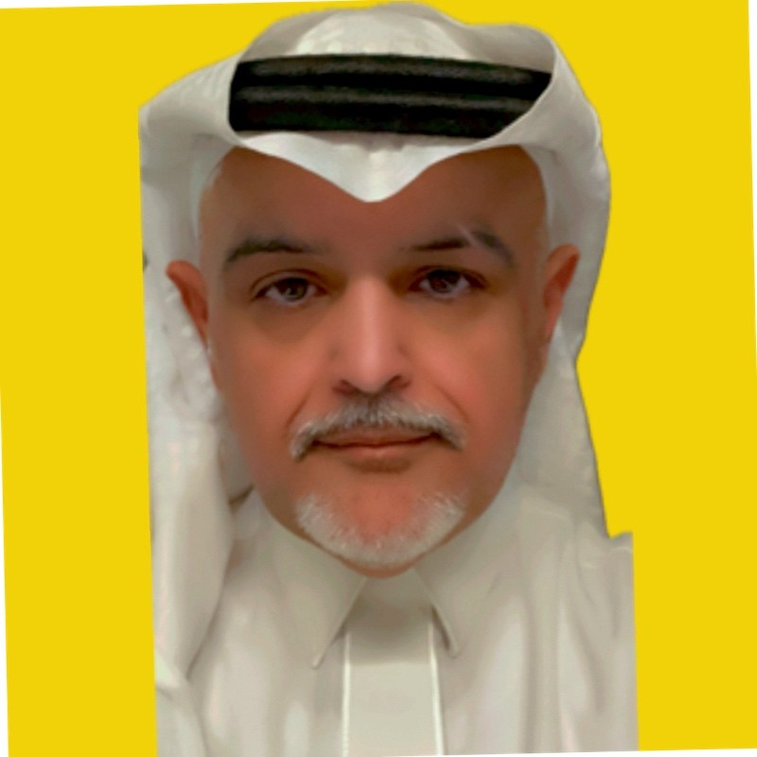


Our team provides deep knowledge in KSA investment market with wide experience in entrepreneurship
Business Case
Juaithen Al Fahad
Chief Executive Officer
Asma Alyemni
Chief Technology Officer
Hassan Alnamer
Chief Business Officer
Experience:
Serial entrepreneur with a portfolio of two startups in the Fintech and entertainment
Ex-Mobily with 29+ years of experience of driving sales
Experience:
CISO of top public entity with 15+ years in information technology
Member Board of Trustees in National Information Technology Academy
Experience:
Management Consultant with 2+ years of supporting the public and private entities
Robust 2+ years of experience in Software development and AI

